Slide 1

NASA TMR RISC-V MCU for CWS
ECEN 499
Zac Carico, James Thomas, Sam Bagley,
Maxwell Bakes, Michael Ashford

Slide 2
Overview:
Purpose
Goals
Hardware & Software
Libero
SoftConsole
Altium
Future Areas of Improvement

Slide 3
Purpose:
Using the PolarFire FPGA Eval kit and a custom PCB, benchmark various RISC-V core configurations in Triple Modular Redundancy (TMR) for use in NASA's Caution and Warning System (CWS) in the Portable Life Support System (PLSS) of the newest space suit (xEMU).

Slide 4
Goals:
PCB
Multi-Channel ADC
LEDs, Switches, GPIO Headers
Accelerometer, Temperature and Humidity Sensor
Heartrate Sensor, Pressure Sensor
LCD Screen, FMC connector
Communication
10 Full-Duplex UART
SPI
I2C
PWM
Create multiple configurations of RISC-V cores in TMR
Benchmark configurations and create a detailed report of the outcome

Slide 5
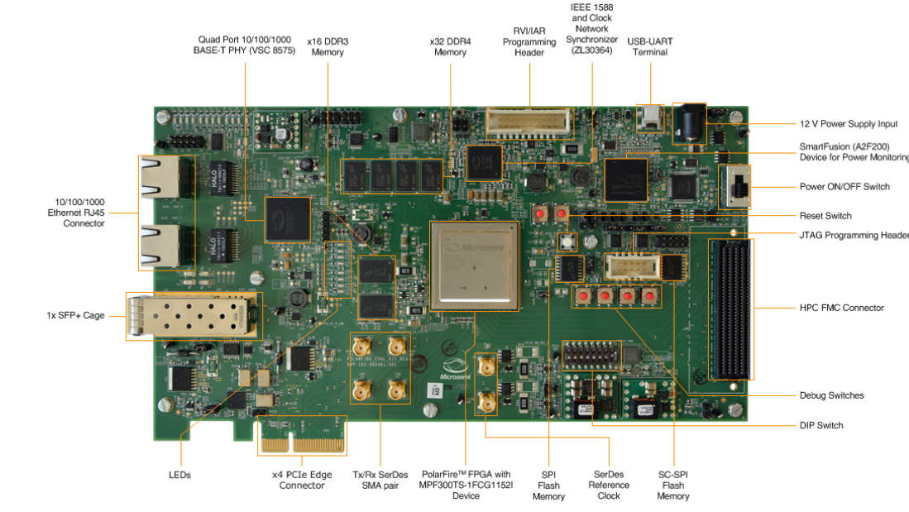
Hardware & Software:
PolarFire FPGA
Libero
SoftConsole
Altium

Slide 6
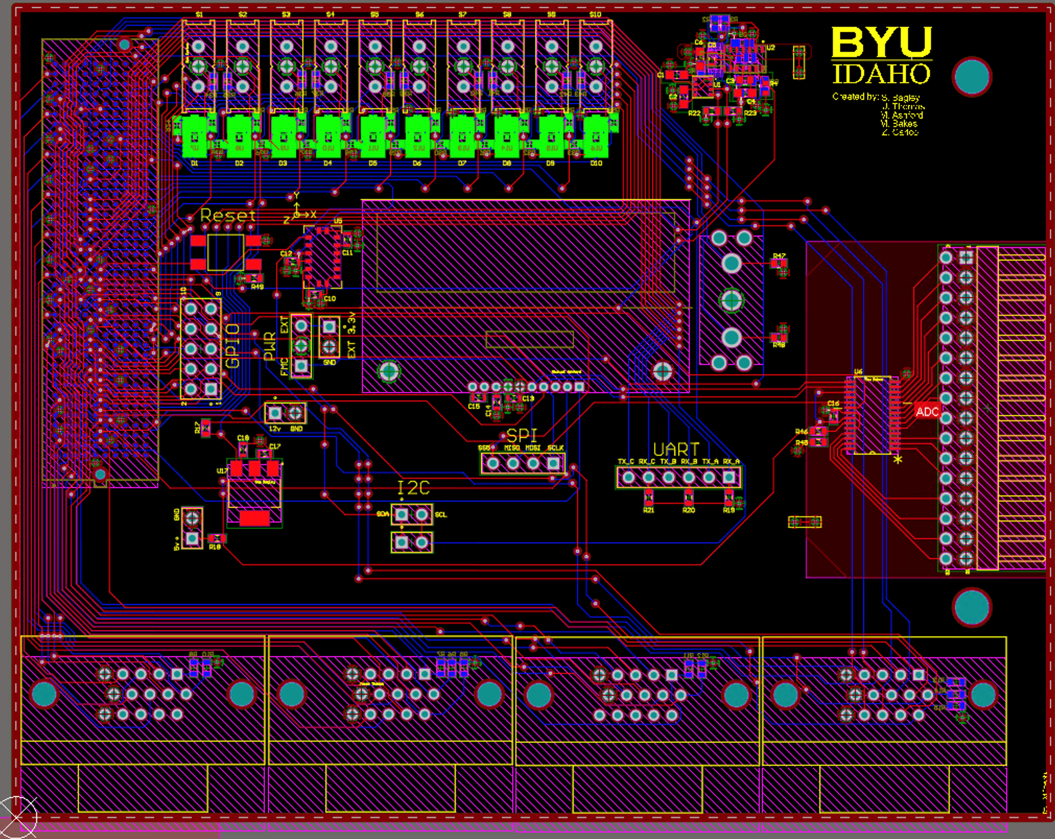
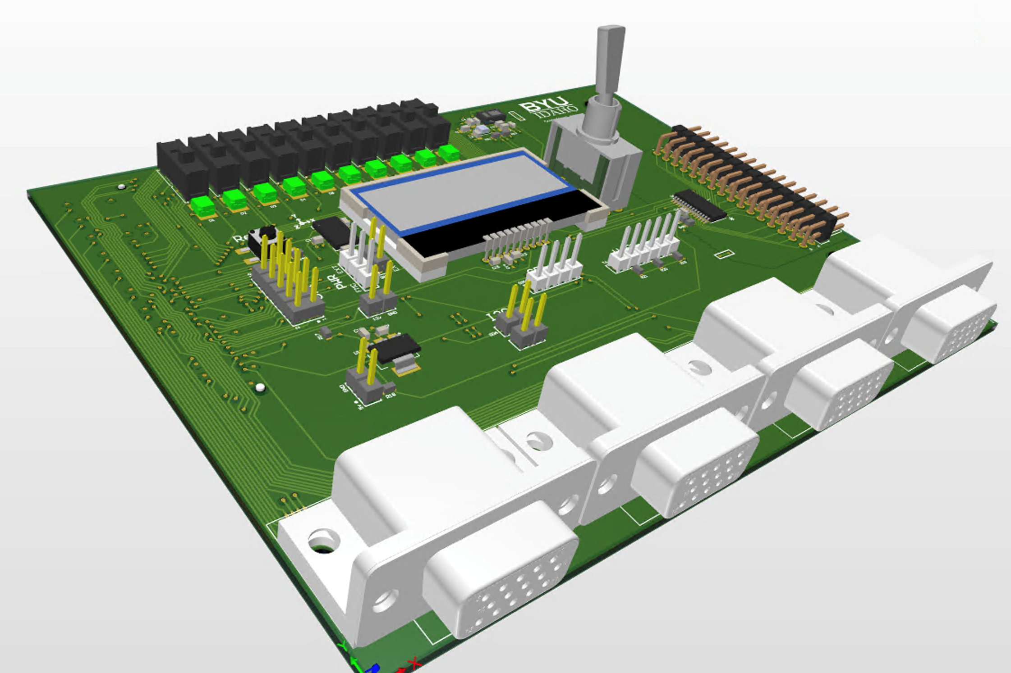
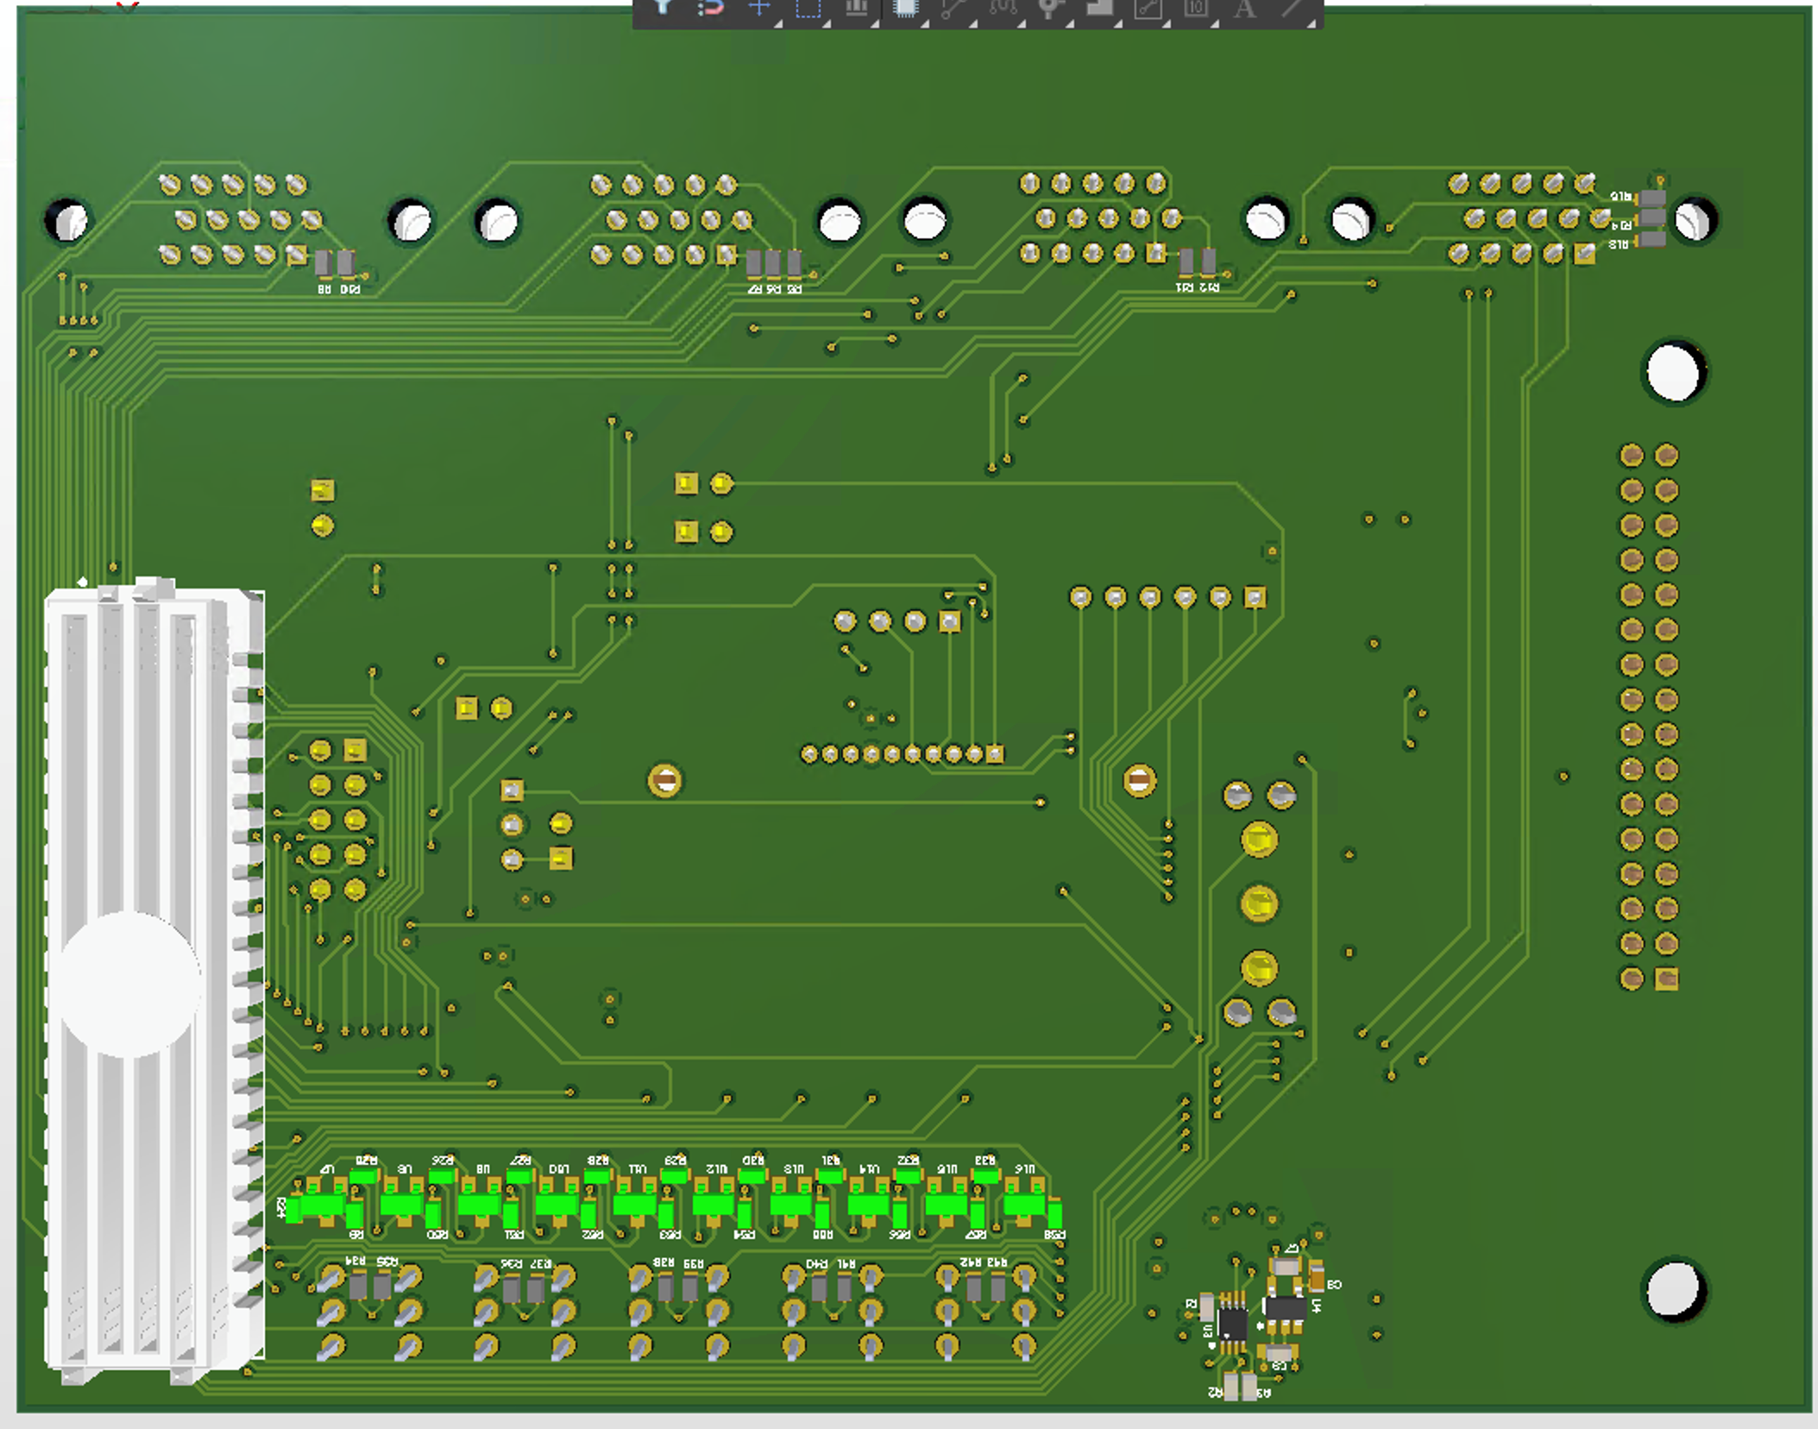
PCB Render:

Slide 7
Libero:
integrates industry standard Synopsys Synplify Pro® synthesis and Mentor Graphics ModelSim® simulation with best-in-class constraints management, Programming & Debug Tools capabilities, and secure production programming support.
Accomplished:
Setup Libero by solving problems with computer hardware and software, as well as fixing issues with anti-virus and physical constraints.
Created a base RISC-V processor in TMR
Started initial configuration of 3 other cores
Created the SPI, I2C, UART, and GPIO modules
Started the creation of the LVDS UART
Yet to be done:
Finish the other three processor designs.
Fix memory controller compatibility issues between AHB processors and AXI memory.
Finish the LVDS UART
Fully test SPI, I2C, GPIO, and LVDS UART

Slide 8
Libero:
integrates industry standard Synopsys Synplify Pro® synthesis and Mentor Graphics ModelSim® simulation with best-in-class constraints management, Programming & Debug Tools capabilities, and secure production programming support.
Problems Overcome:
Finding out that the computer needed 16GB of RAM to synthesize
The anti-virus software (Sophos & Windows Defender) automatically deletes the rwnetlist tool.
Finding that the user needs to disable Sophos completely, copy the rwnetlist file from another folder into the needed directory, run that specific file, and tell Windows Defender to run it anyway with admin privileges
Issues with Place&Route not able to map I/O signals correctly
Place&Route can take over an hour due to the low specs of school computers
Problems Not Overcome:
Mapping the LVDS UART I/O signals correctly
Having multiple people work on the project with only 1 license

Slide 9
SoftConsole:
Free software development environment facilitating the rapid development of bare-metal and RTOS based C/C++ software for Microsemi CPU and SoC based FPGAs.
Accomplished:
Created a SoftConsole project that can run on the first processor design
Finished basic driver code for the LCD screen and ADC that can possibly run on other core configurations (depending on if the APIs change between processors)
Finished testing code for SPI, I2C, and CPU. Can possibly run on other core configurations (depending on if the APIs change between processors)
Created basic benchmarking code
Yet to be done:
Fully test all of the code (some testing has been done by mapping the FPGA connections to the 6 available header pins on the FPGA)
Write driver code for all of the sensors
Write test program for LCD screen, LVDS UART, sensors, ADC, and GPIO

Slide 10
SoftConsole:
Free software development environment facilitating the rapid development of bare-metal and RTOS based C/C++ software for Microsemi CPU and SoC based FPGAs.
Problems Overcome:
Adding in new driver libraries for new modules such as I2C
Correctly configuring the memory addresses for each module so they match with the settings in the Libero project
Properly building and uploading code to FPGA
Problems Not Overcome:
Running code on FPGA in debug mode was very finicky

Slide 11
Altium:
PCB design software and high-powered tools for PCB designers. Industry-leading schematic capture, layout and prototyping tools.
Accomplished:
Imported and created footprints and CAD models for all PCB components
Designed schematics for all pieces showing how everything connects and interfaces with FMC HPC connector
Created PCB layout by routing all pads to their correct connections
Figured out what FMC HPC connections that will interface with the PolarFIre FPGA
Ordered and received completed PCB and components
Yet to be done:
Place and solder all components using the solder mask, solder paste, and a reflow oven
Use probe to test the connections and inspect solder joints
Test as many connections and routes on the PCB as possible BEFORE plugging it into the FMC to verify that the FPGA will not be damaged in any way
Test everything using the FPGA and SoftConsole. Make sure that the LVDS UART is reliable and the LCD screen and 3 position toggle switch works

Slide 12
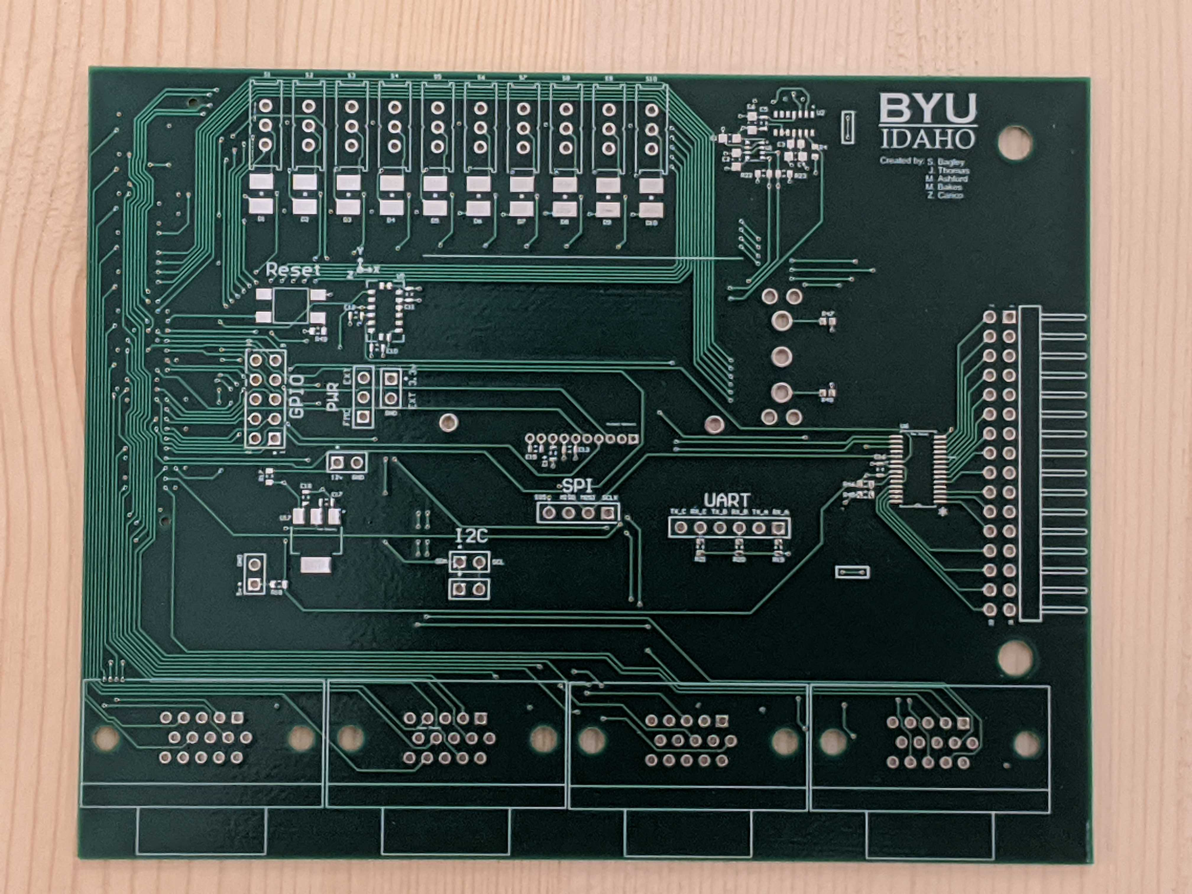
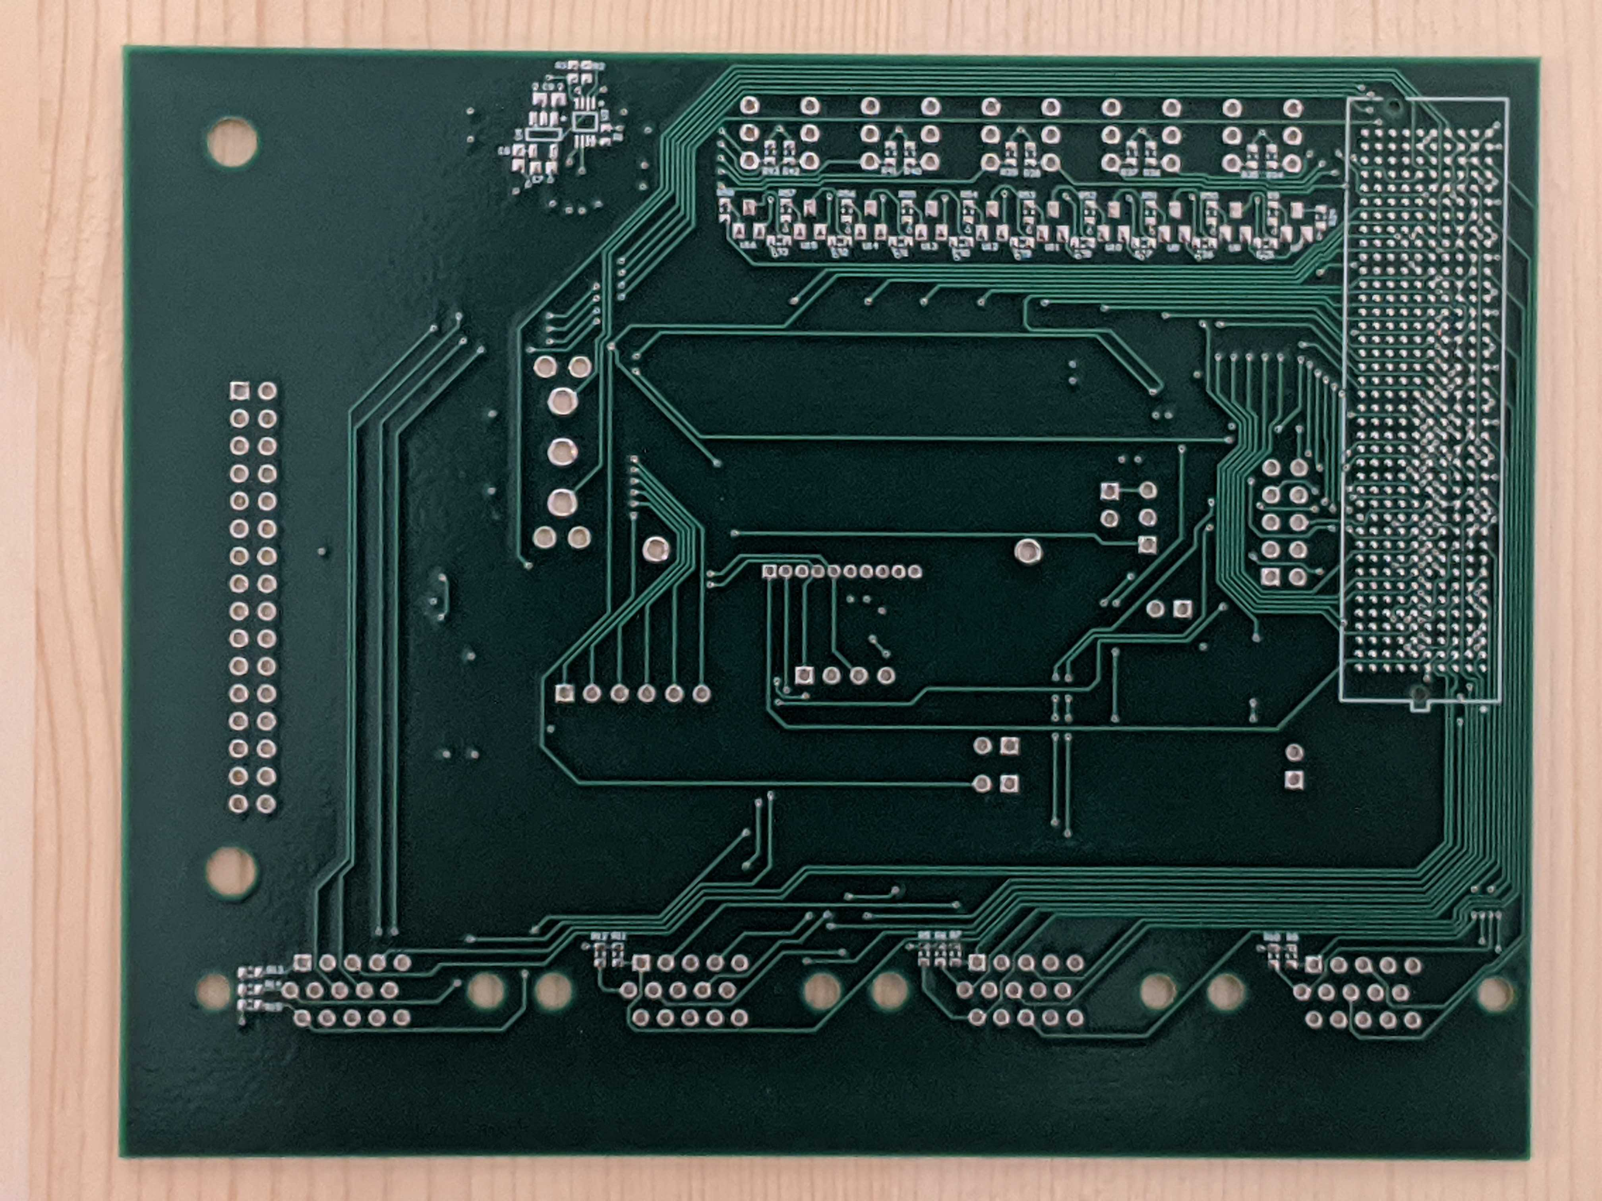
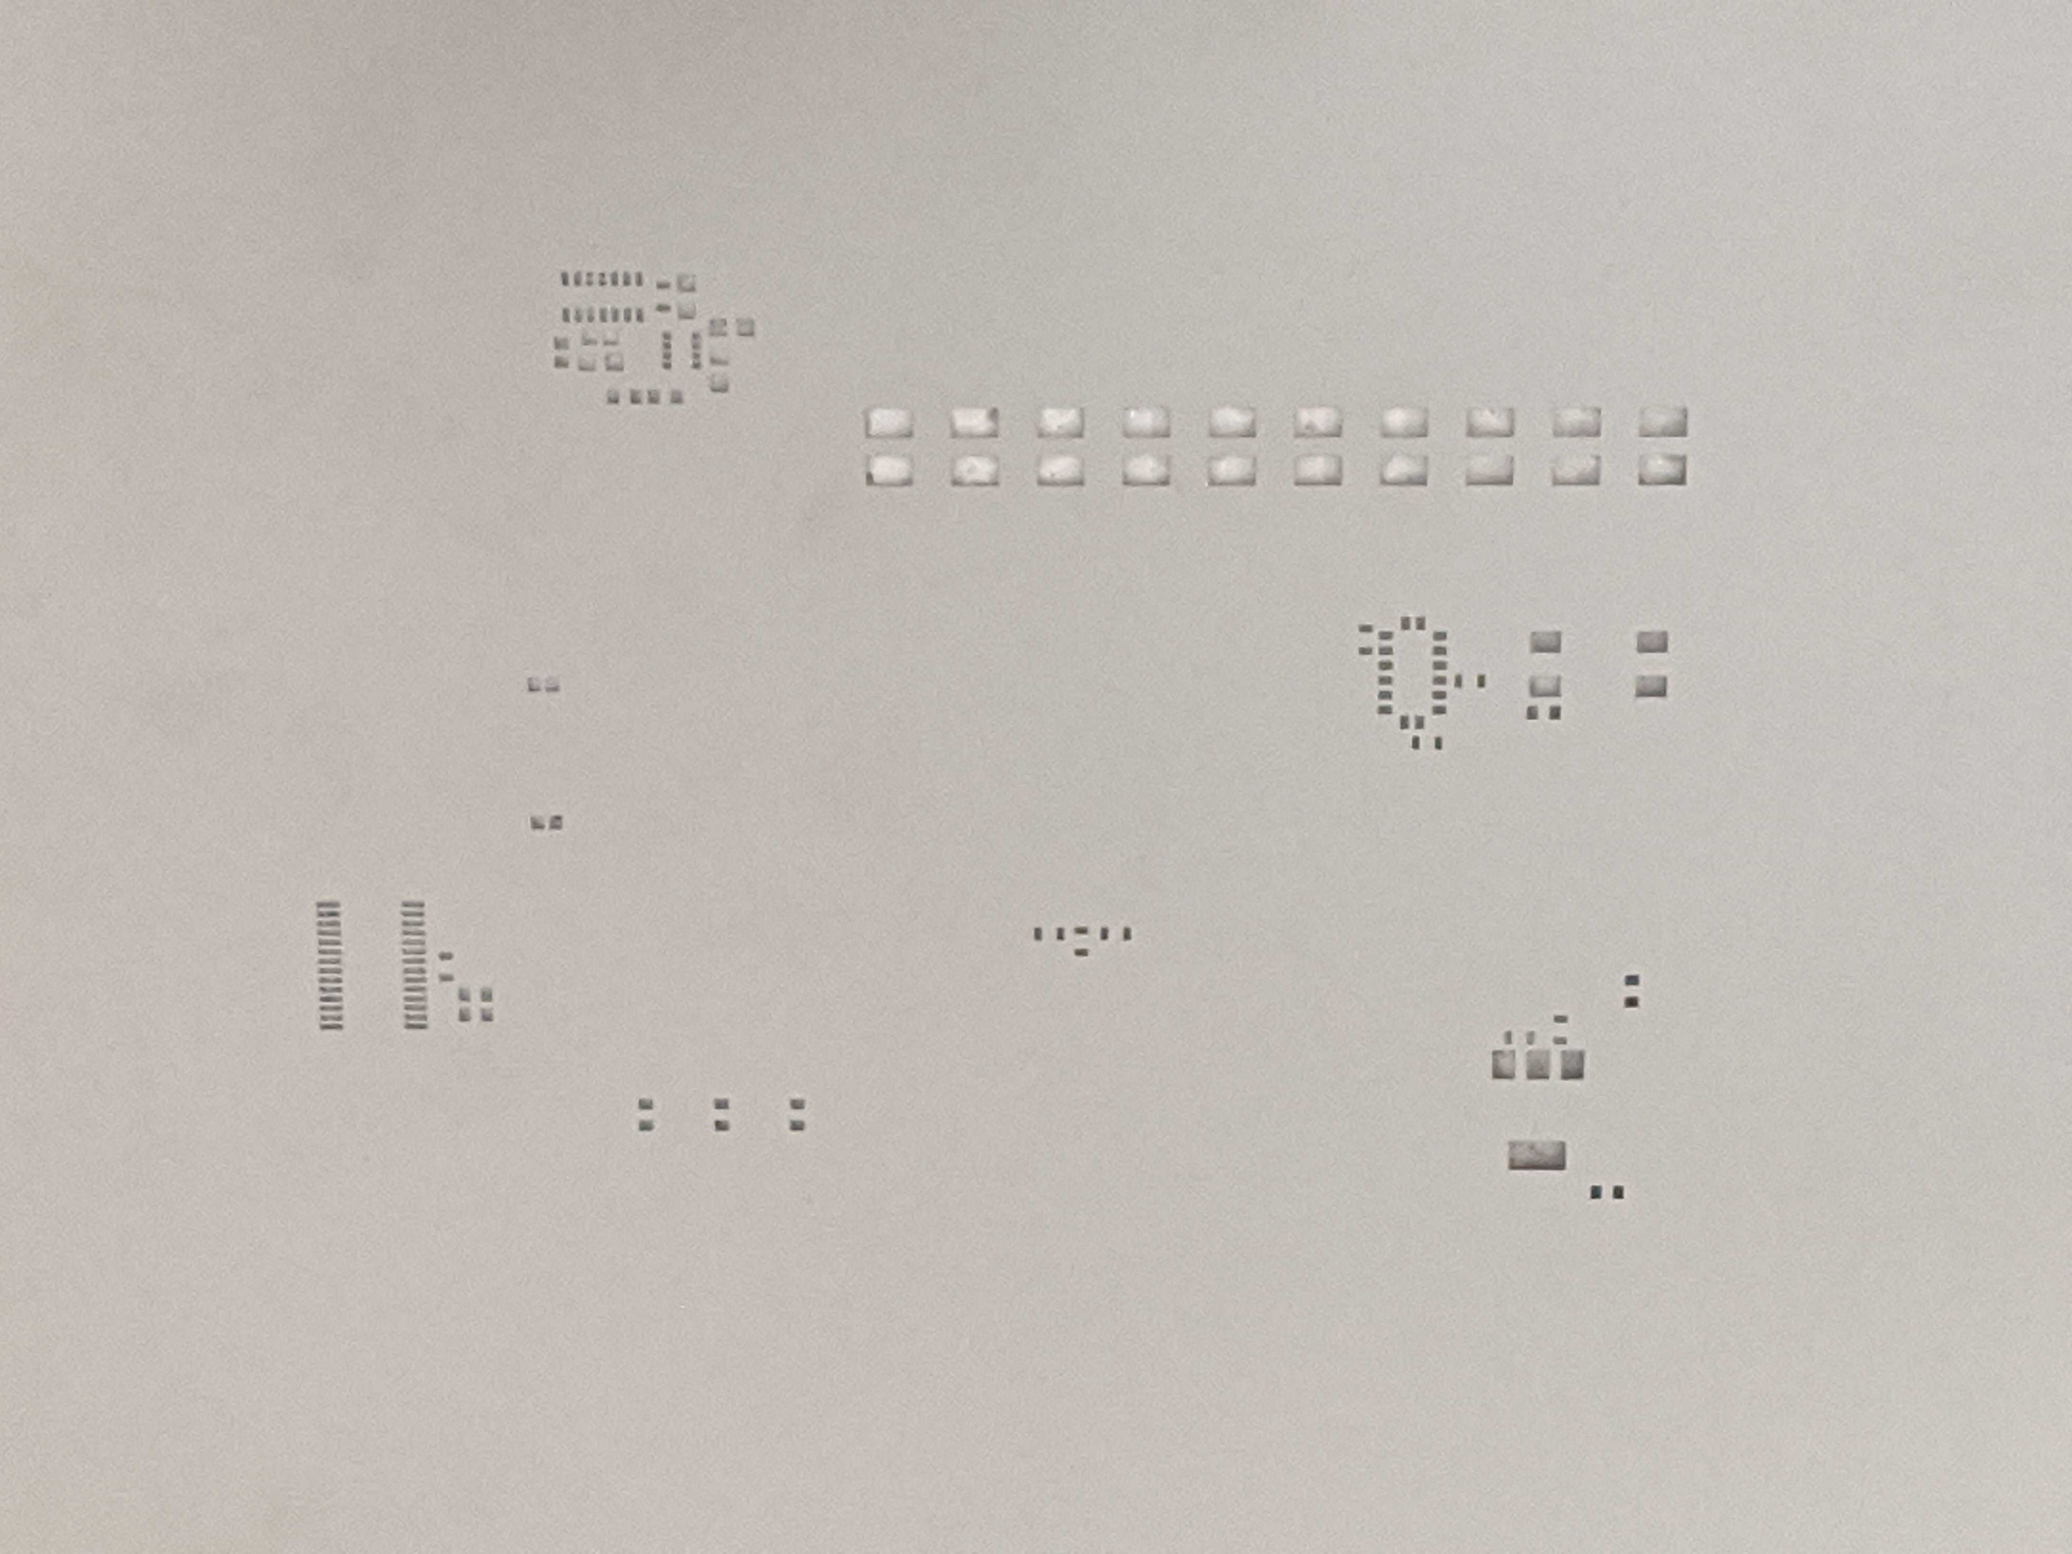
Altium:
PCB design software and high-powered tools for PCB designers. Industry-leading schematic capture, layout and prototyping tools.

Slide 13
Altium:
PCB design software and high-powered tools for PCB designers. Industry-leading schematic capture, layout and prototyping tools.
Problems Overcome:
Had issues with the built in version control
Issue ordering the solder masks
Problems Not Overcome:
Differential pairs not spaced far enough from other differential pairs preventing high speed performance
Altium crashes if too many programs are being run
Difficulties with the Signal Integrity option

Slide 14
Future Areas of Improvement:
PCB
Solder on components
Test functionality
Design a high speed capable board
Space out connections on FMC for ease of routing
Libero
More architectures
Benchmark CPUs

Slide 15
Questions?

Slide 16


